Slide 1
Can Data Integration Quality be enhanced on multi-cloud using SLA?
Daniel Aguiar da Silva Carvalho, Magellan, IAE, Univ. J. Moulin Lyon 3, France
Plácido Antonio de Souza Neto, DIATINF, IFRN, Brazil
Chirine Ghedira-Guegan, Magellan, IAE, Univ. J. Moulin Lyon 3, France
Nadia Bennani, LIRIS-CNRS, INSA-Lyon, Univ. Lyon, France
Genoveva Vargas-Solar, CRNS, LIG-LAFMIA, France
Notes:
Good morning, I am Sebastien Dufromentel from INSA Lyon in France and today I am presenting on behalf of my colleagues that could not make it to the conference. The work is motivated and oriented to answer a research question:
Can Data integration quality be enchanced on multicloud using SLA?
Let’s see how they tried to answer this question.

Slide 2
Agenda
Data integration quality on multi-cloud environments
Data integration challenges: classification scheme
Quantitative analysis
Contribution and outlook
Notes:
The agenda of my presentation... I will begin by introducing our work regarding data integration quality on multi-cloud environments
then i will present the method we followed to identify challenges and open issues
then a quantitative analysis and conclusion...

Slide 3
Data integration
Query
Result
Mediator
This scenario represents the “Classic” data integration scenario
Data source A
Data source B
Data source C
Notes:
We are manly interested in the data integration problem which consists in merging data from different sources and provide to the user a unified view of these data
Let me show you the classical data integration scenario, ... we have different data sources (A, B and C), and a query that must be answered. This query is submitted to a mediator which is responsible for rewriting it in accordance with the different databases. Then the results are returned to the mediator which will be responsible for integrating the data and sending back the integrated result.
As I mentioned before this is the classical data integration scenario... however the emergency of architectures like cloud open new opportunities for data integration considering that now we are not limited to resources availability .

Slide 4
Quality oriented data integration
Different SLA schemas
Query
Result
Different levels of SLA
Mediator
Different SLA measures that express the same aspect in different SLAs
In this new scenario, we believe that the quality on data integration could be enhanced by using SLA contracts
Data provider A
SLA
Data provider B
SLA
Data provider C
SLA
Notes:
Now we can see a new scenario for data integration... where we have different data providers A, B and C geographically disposed on different clouds. In the cloud scenario quality aspects are defined and agreed between the service provider and the service customer through contracts.
Service level agreements (SLA) is an example of these contracts.
As in the classical scenario we have a query that must be answered and this query is submitted to a mediator who will rewrtite it in accordance with the different data providers and the result will be integrated to be sent back to the user.
In this scenario we have some limitations and challenges such as:
* we have different SLAs schemas exported by the providers
* we have different level of SLAs... such as SLAs between the user and the data provider, SLA between the data provider and the cloud, and also SLAs between different data providers..
* we have different measures in different SLAs which have the same meaning
considering this new scenario, the use of SLA on data integration approaches is an open challenge and we believe that the quality on this approaches can be enhanced

Slide 5
Objectives
Categorize and quantify the key contributions and the evolution of the research done on SLA-guided data integration in a multi-cloud environment
Discover open issues and limitations of existing works

Slide 6
Method: systematic mapping (SM)
Build a classification scheme and structure a field of interest
Categorizing a field
Showing frequencies of publications for categories in the scheme
Determining coverage in a certain field
Combine the results to answer specific research questions
Provide a visual summary by mapping the results: coarsed grained overview
Petersen, Kai, et al. ”Systematic mapping studies in software engineering.” 12th International Conference on Evaluation and Assessment in Software Engineering. Vol 17. 2008.
Notes:
The main objectives when performing a systematic mapping are two:
1. Build a classificaiton scheme and structure a field of interest, in our case quality of data integration on multi-cloud environments using SLA
2. And thereby provide a Visual summary of current published contributions to answer specific research questions.

Slide 7
SM Process
Definition of research question
Conduct search
Papers screening
Keywording using abstracts
Data extraction and mapping process
Review scope
All papers
Research papers
Classification scheme
Systematic map
Notes:
The process consists in five steps, from the definition of resarch questions to the generation of quantitative vision of the state of the art. Each phase produces a concrete result that will eventually help to perform an analytic study and a state of the art of the field.
I will describe briefly each phase and show concretely what we did in our work.

Slide 8
Definition of research question
Definition of research question
Conduct search
Papers screening
Keywording using abstracts
Data extraction and mapping process
Find out, what you want to accomplish
Find out, where you want to search for your information
⇒ Identify forums for research areas
Review scope
All papers
Research papers
Classification scheme
Systematic map
Notes:
the definition of a research scope by defining research questions have as objective to find out…
As in our study, the aim was to (i) categorize and quantify the key contributions and the evolution of the
research done on SLA-guided data integration in a multi-cloud environment and
(ii) discover open issues and limitations of existing works, the research questions retained are: (slide suivant)

Slide 9
Defining research questions
RQ₁: Which are the SLA measures that have been mostly applied in the cloud?
RQ₂: How have published papers on data integration evolved towards cloud topics?
RQ₃: In which way and in which context data integration have been used to Quality of Service (QoS) measures in the literature?
Notes:
RQ1: Which are the SLA measures that have been mostly applied in the
cloud?
>> This question identifies the type of properties used for characterizing
and evaluating the services provided by different clouds.
RQ2: How have published papers on data integration evolved towards cloud
topics?
>>> This question is devoted to identify the way data integration problems
addressed in the literature started to include issues introduced by the cloud.
RQ3: In which way and in which context has data integration been linked
to Quality of Service (QoS) measures in the literature?
>>> The objective of this question is to understand which QoS measures have been used for evaluating
data integration and to determine the conditions in which specific measures are
particularly used.

Slide 10
Conduct search
Definition of research question
Conduct search
Papers screening
Keywording using abstracts
Data extraction and mapping process
Search for primary studies
Define queries in scientific database: terms, research question, aspect (expert)
Have several study types to avoid bias
Review scope
All papers
Research papers
Classification scheme
^{Query} applied to check keyword, title, and abstract fields within the corresponding databases
Systematic map
Notes:
The second step of the SM process is how to conduct search with the constraints to
define…
Have …

Slide 11
Retrieving candidate papers
(“Service level agreement” AND (“Data integration” AND “Database integration”) AND (“Cloud” AND “Multi-cloud ”))
Database | Amount
IEEE | 658
ACM | 649
Science Direct | 106
CiteSeerX | 419
Total | 1832
Notes:
According to our research questions and our expertise in data integration we
chose a set of keywords to define a complex query to be used for retrieving papers
from four target publication databases: IEEE , ACM , Science Direct and
CiteSeerX . We used the following conjunctive and disjunctive general query
which was completed with associated terms from a thesaurus and rewritten
according to the expression rules of advanced queries in each database:
("Service level agreement" AND ("Data integration" OR "Database
integration") AND ("Cloud" OR "Multi-cloud "))
A total of 1832 publications was found.

Slide 12
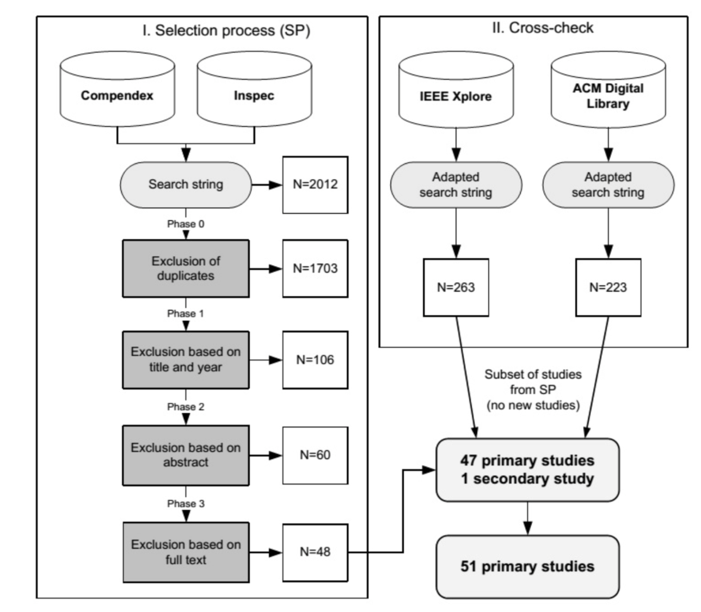
Papers screening
Notes:
The idea behind the paper screening step is to find out the set of papers that matches the questions of our study.
Based on a set of chosen exclusion and inclusion criteria, this paper screening step will lead to unselect subsets of works that do not fit the initial questions
On this slide, examples of those criteria could be duplication, year of publication … etc

Slide 13
Keywording using abstracts
Definition of research question
Conduct search
Papers screening
Keywording using abstracts
Data extraction and mapping process
Reviewers read abstracts
Look for keywords and concepts
Reflect the contribution of a paper
Identify contexts
Review scope
All papers
Research papers
Classification scheme
Systematic map
Notes:
The next step then takes the finally selected subset. The reviewers then read abstracts….then look for… etc
The result of the paper screening step in our case is illustrated by the following slide.

Slide 14
Selecting relevant papers
The titles and abstracts of the papers were filtered to select paper related to our research scope
Database | Amount | Included | Excluded
IEEE | 658 | 56 | 602
ACM | 649 | 31 | 618
Science Direct | 106 | 6 | 100
CiteSeerX | 419 | 21 | 398
Total | 1832 | 114 | 1718
Notes:
This subset will be studied deeply in order to classify the works according to a set of elements described in next lide

Slide 15
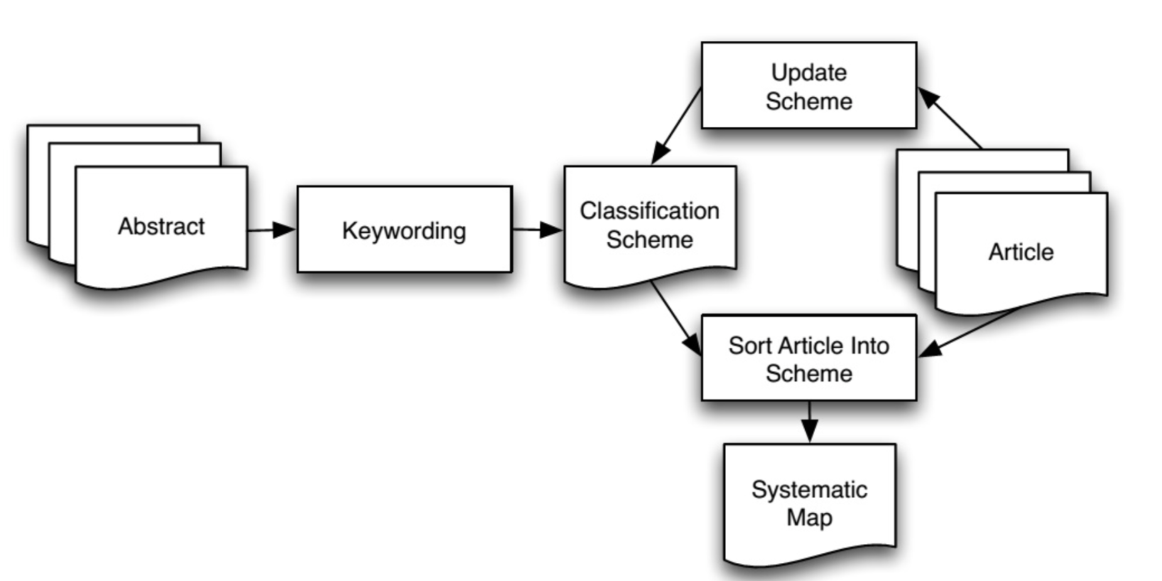
Building a classification scheme
Notes:
Briefly the classification scheme is an iterative process consisting first in taking the abstract and the keywords to propose an initial classification scheme that will be refined reading diagonally the papers.
More precisely, it consiste in Putting all keywords together from all found papers
Develop higher level view on the research
Define categories representing the underlying sets of papers
When abstracts don’t contain enough information, the introduction and conclusion are reviewed as well
The final set of keywords is used to cluster and form categories as illustrated in next slide for our case of study

Slide 16
Classification scheme
Data integration
environment
Data integration
description
Data quality
Confidentiality
Privacy
Security
SLA
Data protection
Data provenance
Others
Cloud
Data Warehouse
Federated Database
Multi-cloud
Schema
Meta-data
Knowledge
Notes:
For instance the higher level view allows us to obtain three categories the first one concerns the environment of the data integration, the second more oriented to the data integration description and finally the third concerns Data quality.
For each category, the set of keywords caracterizing the works are kept in each category.

Slide 17
Data extraction & mapping process
Definition of research question
Conduct search
Papers screening
Keywording using abstracts
Data extraction and mapping process
Frequencies can be derived from a final classification table
This shows the latest research focus and possible research for the future
Different facet combinations are possible
→ e.g. Context facet + research facet or contribution facet
Review scope
All papers
Research papers
Classification scheme
Systematic map
Notes:
The final step consists in an accountability process. It consists in building tables where each category versus keyword is counted.
Then the obtained tables could be refined classifying the works according to a set of facets. For our case we chose the context, the research and the contribution facet.

Slide 18
Agenda
Data integration quality on multi-cloud environments
Data integration challenges: classification scheme
Quantitative analysis
Contribution and outlook
Notes:
One performed the collection and cleaning phases of the systematic mapping method, it is possible to perform a qualitative analysis in order to answer the initial research questions based on the numbers. Authors used bubble charts for aggregating the data and generating a views according to the proposed classification scheme.

Slide 19
SLA measures and the cloud
RQ₁: Which are the SLA measures that have been mostly applied in the cloud?
Privacy and security are the most popular SLA measures
SLA is considered mainly in multi-cloud
Notes:
Recall the first research question intended to identify the SLA measures that have been mostly applied in the cloud
Therefore we combined three categories of our proposed classification scheme the one concerning quality measures, data integration description and data integration environment. Aggregating papers dealing with these categories, whe observed that click
Privacy
SLA

Slide 20
Towards data integration on the cloud
RQ₂: How have published papers on data integration evolved towards cloud topics?
SLA has emerged when cloud issues started to be addressed around 2009 and 2012
# of publications has increased as cloud has become more popular and accessible
Notes:
The objective of the second research question was to observe the evolution of publication trends towards the cloud, and how it was related to SLA issues. We observed that
SLA publications emerged when
The # of publications

Slide 21
Data integration and quality
RQ₃: In which way and in which context has data integration been used with QoS measures in the literature?
Data integration and QoS measures are associated within cloud and multi-cloud
Still an open issue
Notes:
Finally, research question number three explored in which way and context has data integration been used with QoS measures
Three categories were coupled again: Data integration environment, data integration description and Measures, since Quality can be considered both while describing data integration strategies and within specific architectures. Concretely the cloud and multi – cloud are the architectures that most consider QoS … but in fact few papers address both aspects, and some issues seem still open.

Slide 22
Other observations
The cloud is the most popular deployment environment particularly for data integration tools that have been delivered as concrete solutions
Notes:
Other interesting observations were analyzed by combining the data integration Environments, with the type of contributions and research developed. The analysis shos that
The cloud is …
Of course the paper referes and argues about other observations and combinations of categories that lead to have a quite interesting picture of works addressing data integration, in multi-cloud conditions and that integrate SLA or some QoS measures to it. Due to time let us rather try to give elements to answer the initial question:

Slide 23
Can Data Integration Quality be enhanced on multi-cloud using SLA?
Notes:
Can data …?

Slide 24
Lessons & Contribution
Trends and open issues on SLA guided multi-cloud data integration show that
Marrying both elements better copes with cloud service provision philosophy
Quality understood by the user and the cloud provider must be integrated under the same vision, in this case the SLA’s
SLA assessment must be integrated within the whole data integration process
Data integration classification scheme that
characterizes a:
modern vision of data integration in multi-cloud environments
enhanced by including SLAs in its process
is supported by the analysis of the literature considering the most popular paper databases and applying the SM method
Notes:
Trends and ....
So the contribution of this paper is a data integration classification scheme that:
-characterizes a:
Is supported by ...

Slide 25
Outlook
Definition of the general lines of an original data integration solution based on an SLA model
Development of strategies to better define an SLA extension and data consumers preferences description for guiding data integration in multi-cloud environments
Definition of a query rewriting model guided by SLA measures
Notes:
According to our study they are currently working on the
Definition
- Development
Definition

Slide 26
Thank you for your attention!
Daniel Aguiar da Silva Carvalho, Magellan, IAE, Univ. J. Moulin Lyon 3, France
Plácido Antonio de Souza Neto, DIATINF, IFRN, Brazil
Chirine Ghedira-Guegan, Magellan, IAE, Univ. J. Moulin Lyon 3, France
Nadia Bennani, LIRIS-CNRS, INSA-Lyon, Univ. Lyon, France
Genoveva Vargas-Solar, CRNS, LIG-LAFMIA, France

Slide 27
References
Mohamad Hamze, Nader Mbarek, and Olivier Togni. Self-establishing a Service Level Agreement within autonomic cloud networking environment. In 2014 IEEE Network Operations and Management Symposium (NOMS), pages 1-4. IEEE, May 2014.
Carlos Pedrinaci, Jorge Cardoso, and Torsten Leidig. Linked USDL: A vocabulary for web-scale service trading. In The Semantic Web: Trends and Challenges - 11th International Conference, ESWC 2014, Anissaras, Crete, Greece, May 25-29, 2014. Proceedings, pages 68{82, 2014.
Kai Petersen, Robert Feldt, Shahid Mujtaba, and Michael Mattsson. Systematic mapping studies in software engineering. In Proceedings of the 12th International Conference on Evaluation and Assessment in Software Engineering, EASE'08, pages 68-77, Swinton, UK, UK, 2008. British Computer Society.
Pramod J Sadalage and Martin Fowler. NoSQL distilled: a brief guide to the emerging world of polyglot persistence. Pearson Education, 2012.
Stephen S. Yau and Yin Yin. A privacy preserving repository for data integration across data sharing services. IEEE T. Services Computing, 1(3):130-140, 2008.

